Slide 1
2-tone test steps for IIP3
Using QPSS & QPAC analyses on Virtuoso

Slide 2
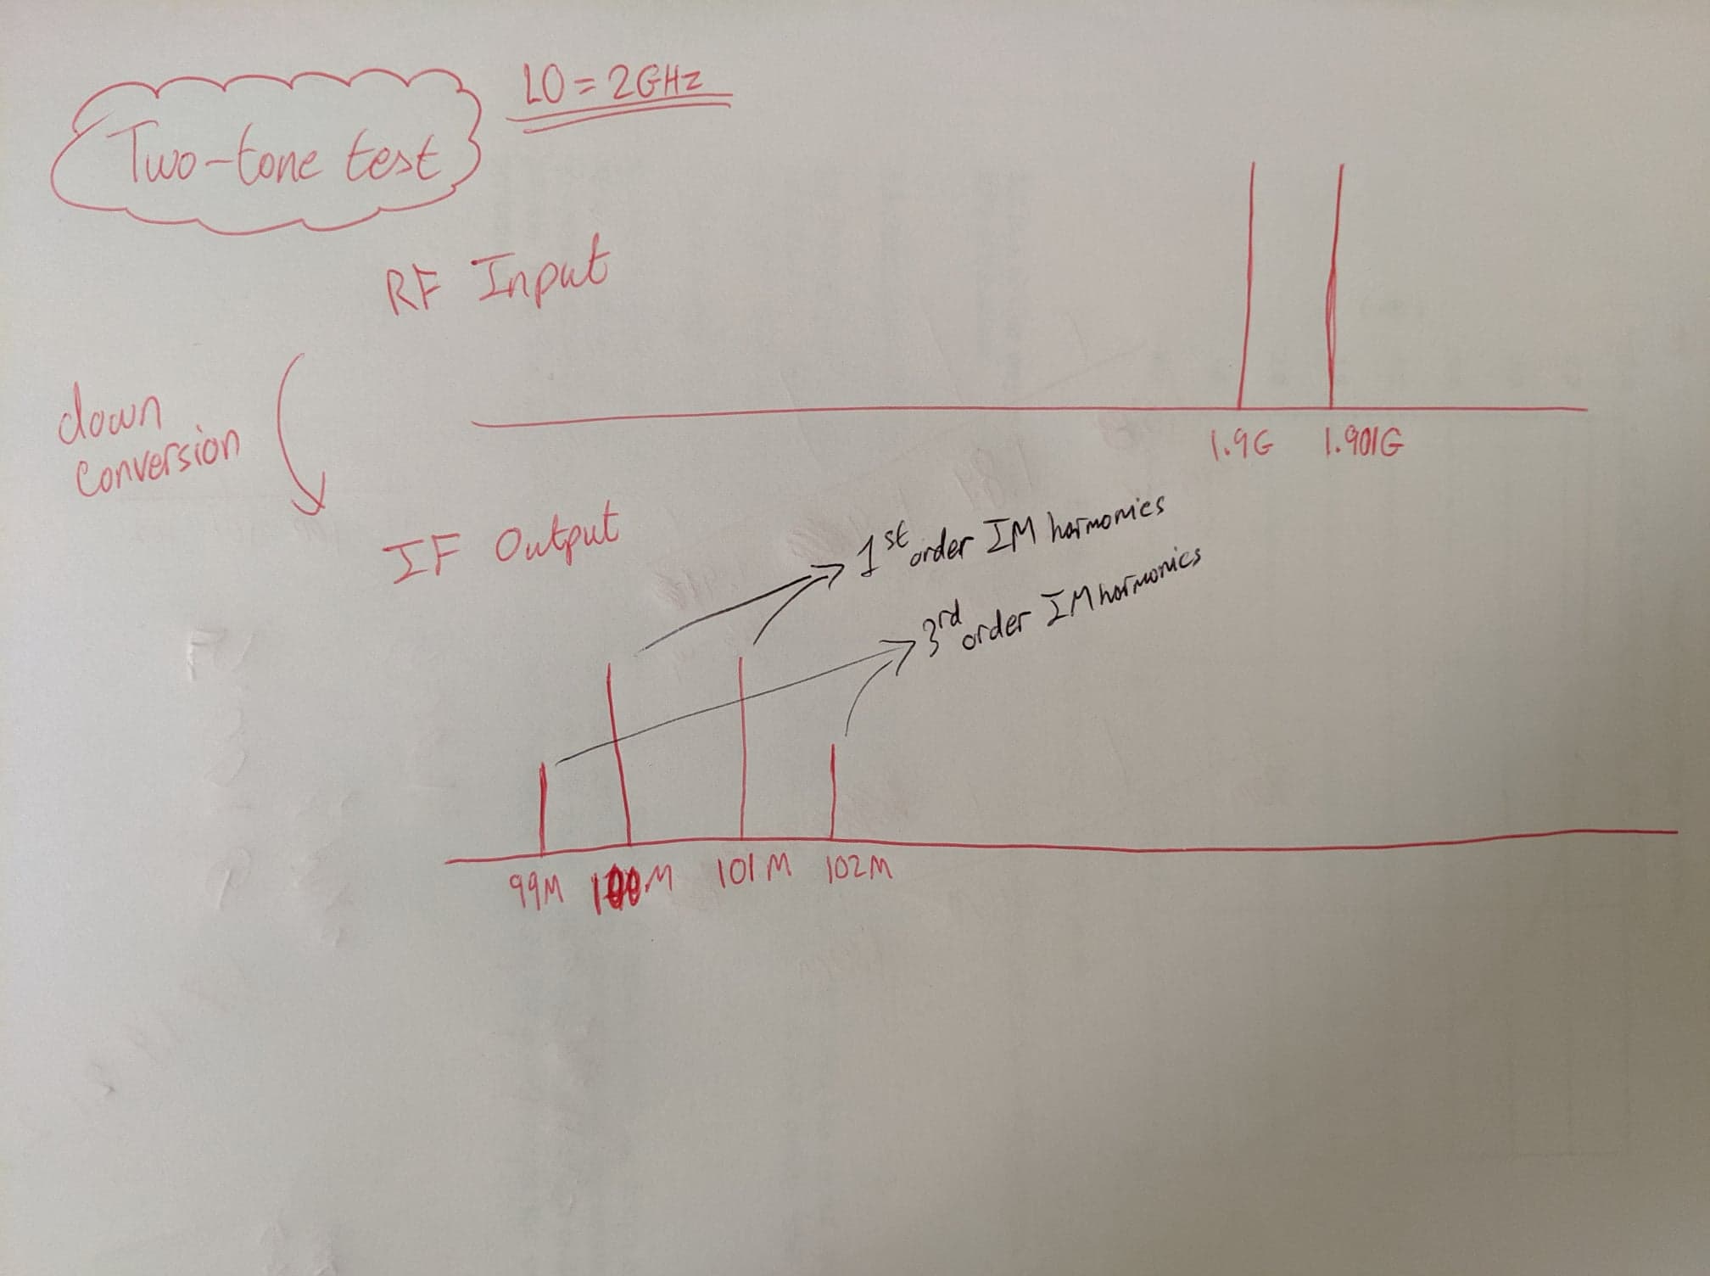
Idea

Slide 3
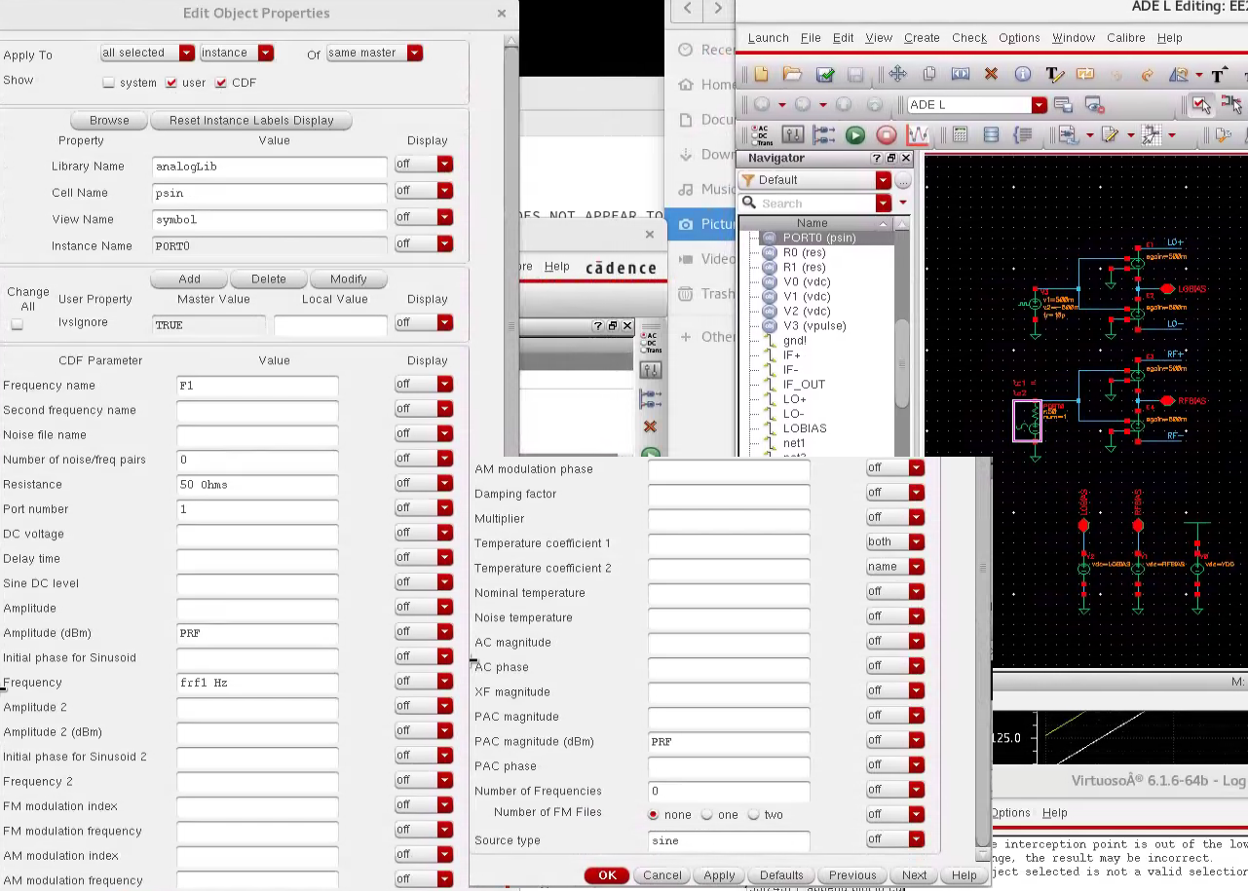
1) Modify the RF (input) source

Slide 4
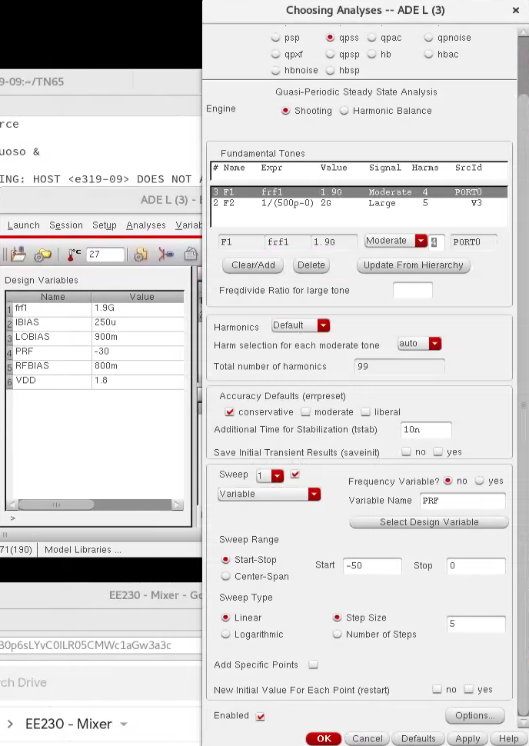
2) QPSS settings

Slide 5
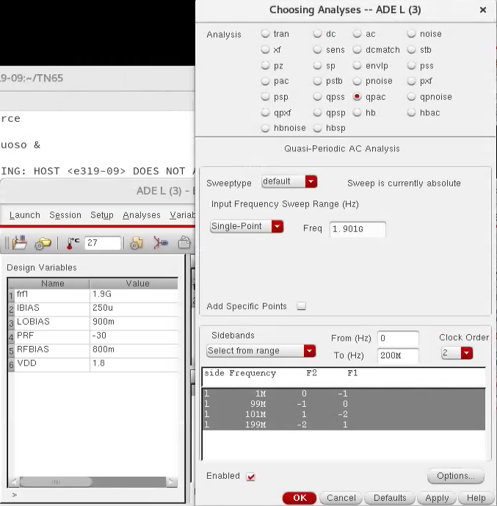
3) QPAC settings

Slide 6
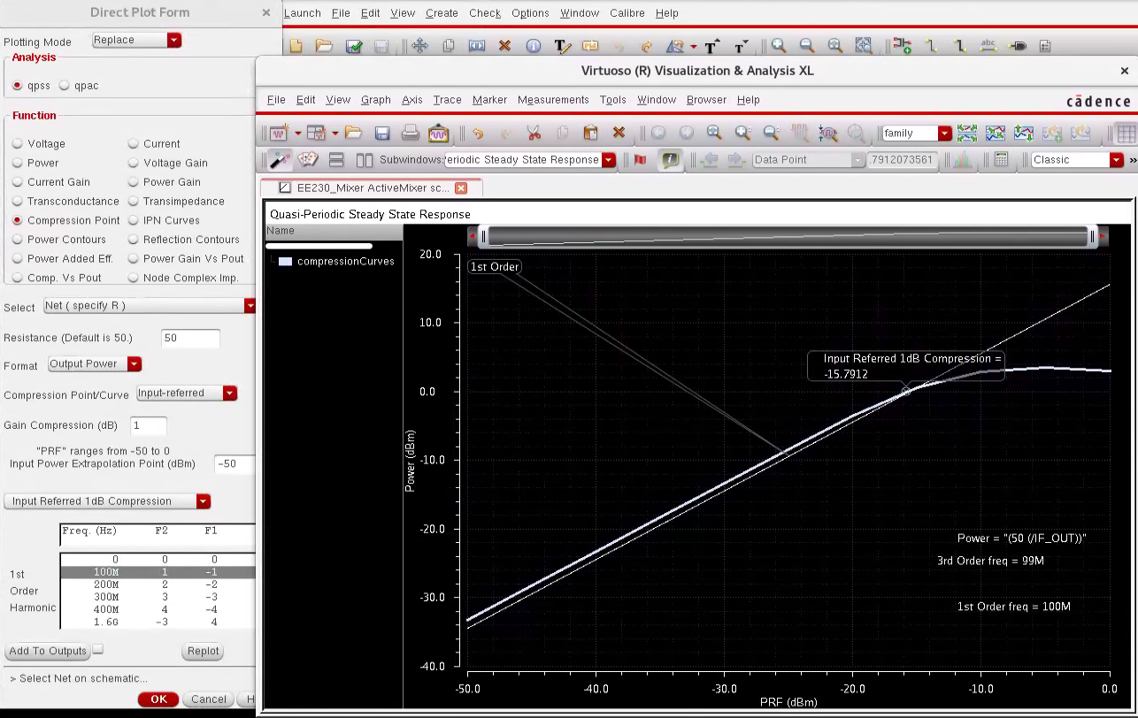
4) Results → P1dB point

Slide 7
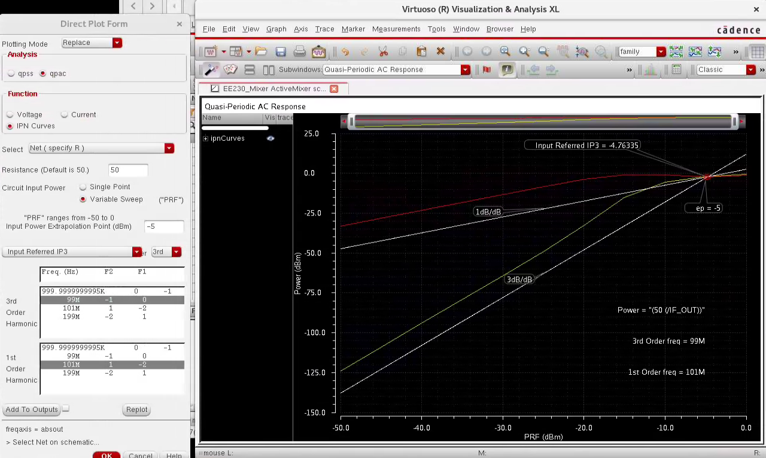
5) Results → IIP3 point

